Slide 1
HIDING IMAGES WITHIN VIDEO USING MACHINE LEARNING

Slide 2
INTRODUCTION
Steganography has become great area of interest for researchers as need for secure transaction of information is increasing day by day. Information may be text, image, audio or video. Steganography is a technique in which required information is hided in any other information such that the second information does not change significantly and it appears the same as original. This paper presents a novel approach of hiding image in a video. The proposed algorithm is AES(ADVANCED ENCRYPTIN STANDARD). It becomes very difficult for intruder to guess that an image is hidden in the video as individual frames are very difficult to analyze in a video running at 30 frames per second.

Slide 3
ALGORITHM FOR IMAGE HIDING
AES
The AES Encryption algorithm (also known as the Rijndael algorithm) is a symmetric block cipher algorithm with a block/chunk size of 128 bits. It converts these individual blocks using keys of 128, 192, and 256 bits. Once it encrypts these blocks, it joins them together to form the ciphertext

Slide 4
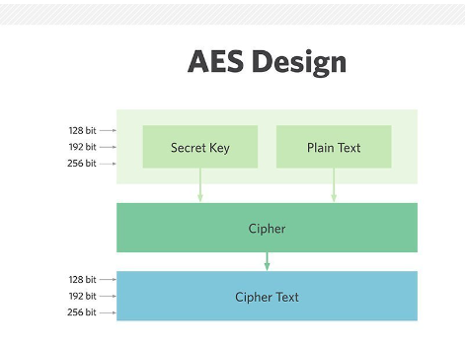
AES DESIGN
.

Slide 5
METHODOLOGY
The main objective of this work is to hide data (images or video) within another video file, where secret image and the cover image has similar resolution size.
The strategy used is image compression using AES algorithm. The train system has to learn to compress the data from the secret images into the least visible portions of the cover image.

Slide 6
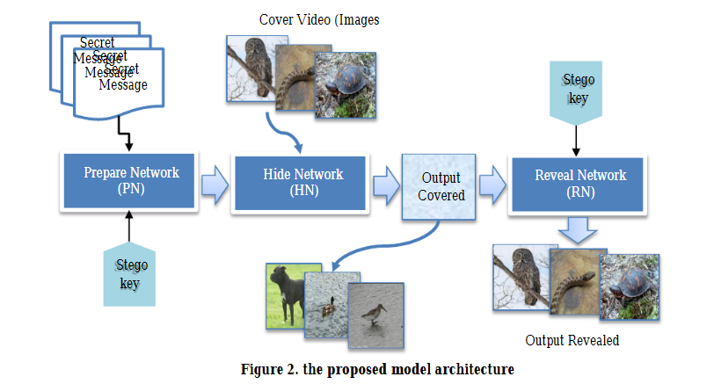
ARCHITECTURE

Slide 7

REGISTER PAGE

Slide 8
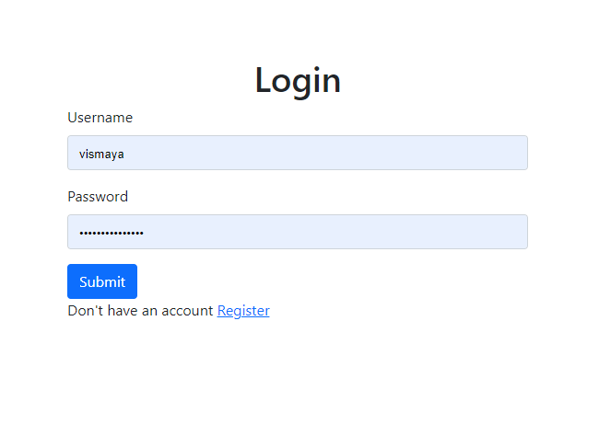
LOGIN PAGE

Slide 9
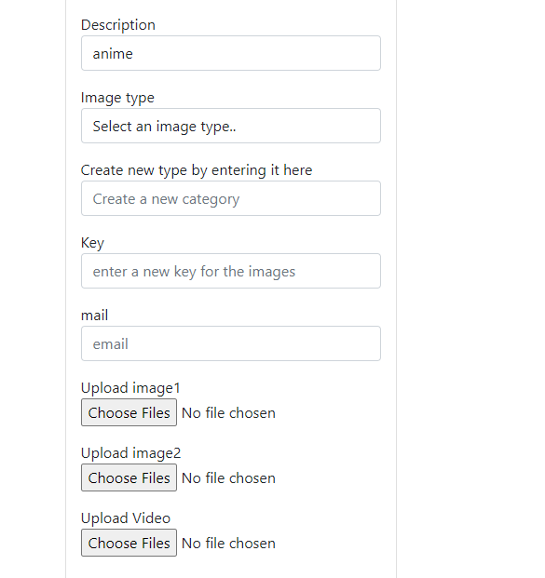

Slide 10
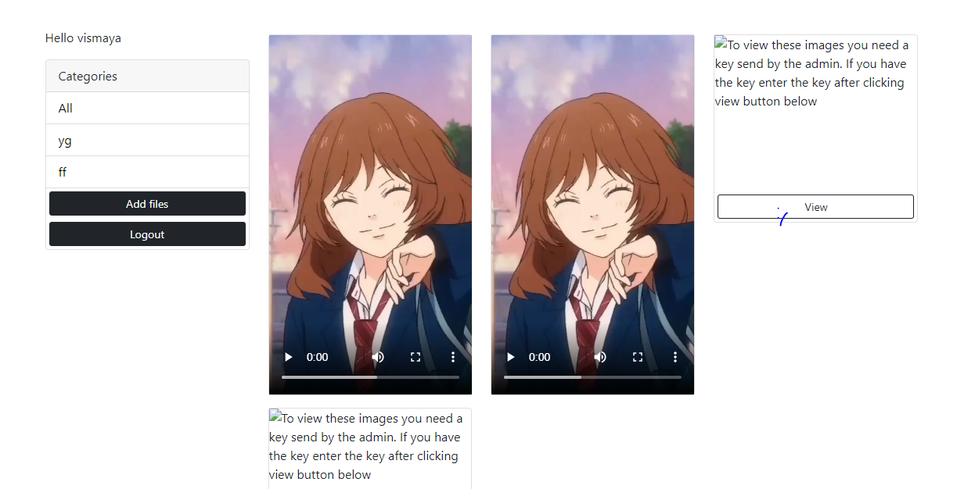
OUTPUT

Slide 11
FUTURE WORK
I have developed a system to hide image in a video stream. The developed system worked excellently and it is very useful in sending sensitive information securely. Industry demands high level research work in steganograpgy , More quick algorithms may be developed and some heuristic approaches may be developed for this purpose.

Slide 12
CONCLUSION
In this work, a video steganography method has been designed based on AES algorithm, and the main goal is to achieve improvement in some stego aspects, including capacity, visibility, and higher resistance to cryptanalysis attack. From results it can point the following:
As the model involves two inputs and outputs, thus, a custom generator had being used to feed the system with input images (from video file) and cover image from the cover image directory.

Slide 13
REFERENCES
1. F 5 algorithm implementation: 2009, Fridrich, J.R.Du, M. Long: Steganalysis In Color Images, Binghamton, 2007.
2. Soumyendu Das, Subhendu Das, Bijoy Bandyopadhyay, Sugata Sanyal, Steganography and Steganalysis: Different Approaches,
3. Steganography Primer - Ruid, Computer Academic underground,2004

Slide 14
THANK YOU

